Slide 1
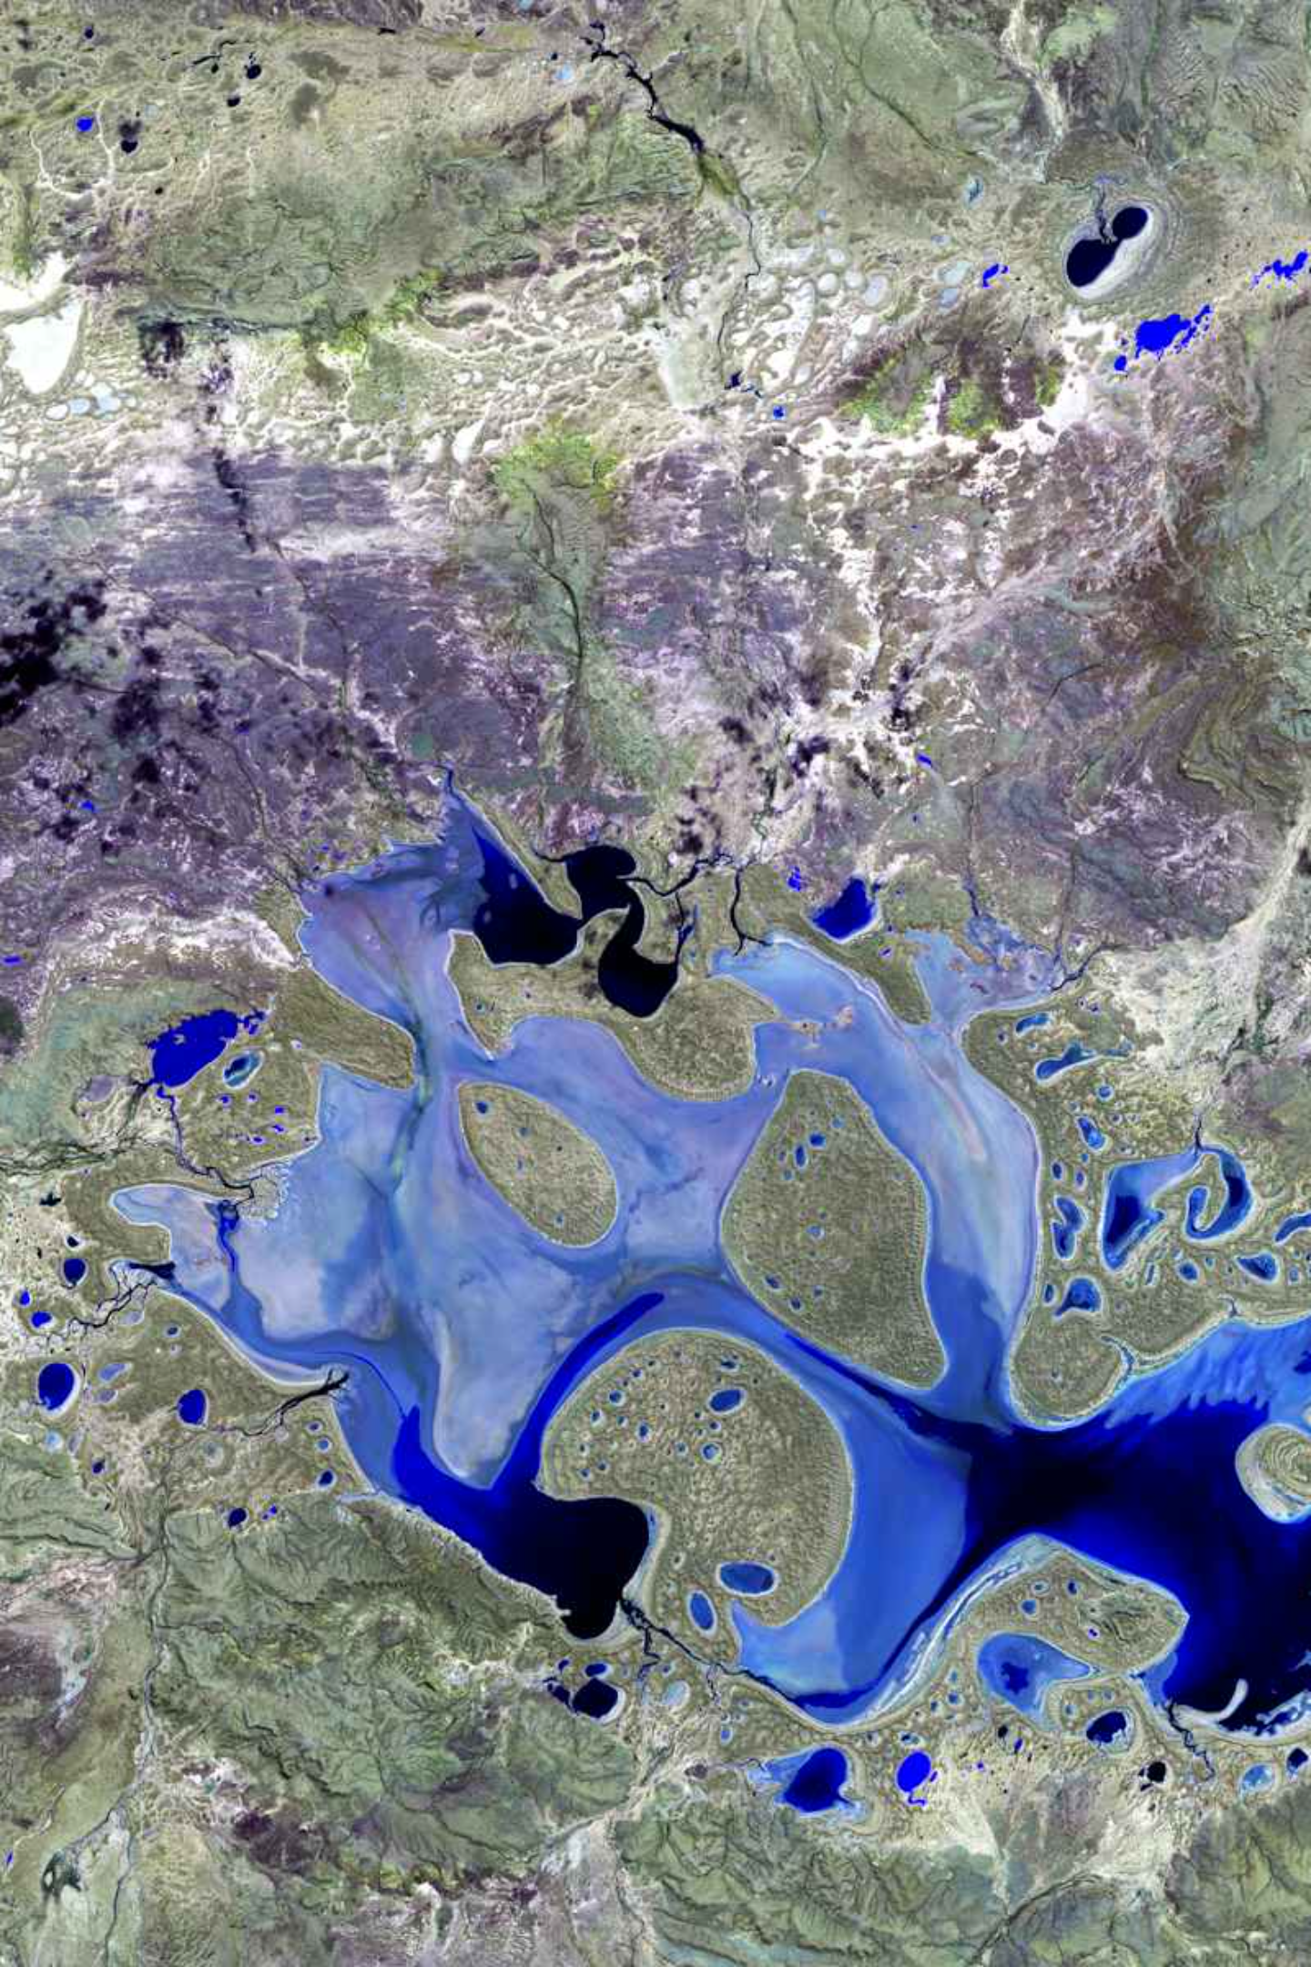
Predicting Algal Blooms
Leveraging remote sensing and environmental data for lake conservation.
ADITYA VERMA
RA2311050010083

Slide 2
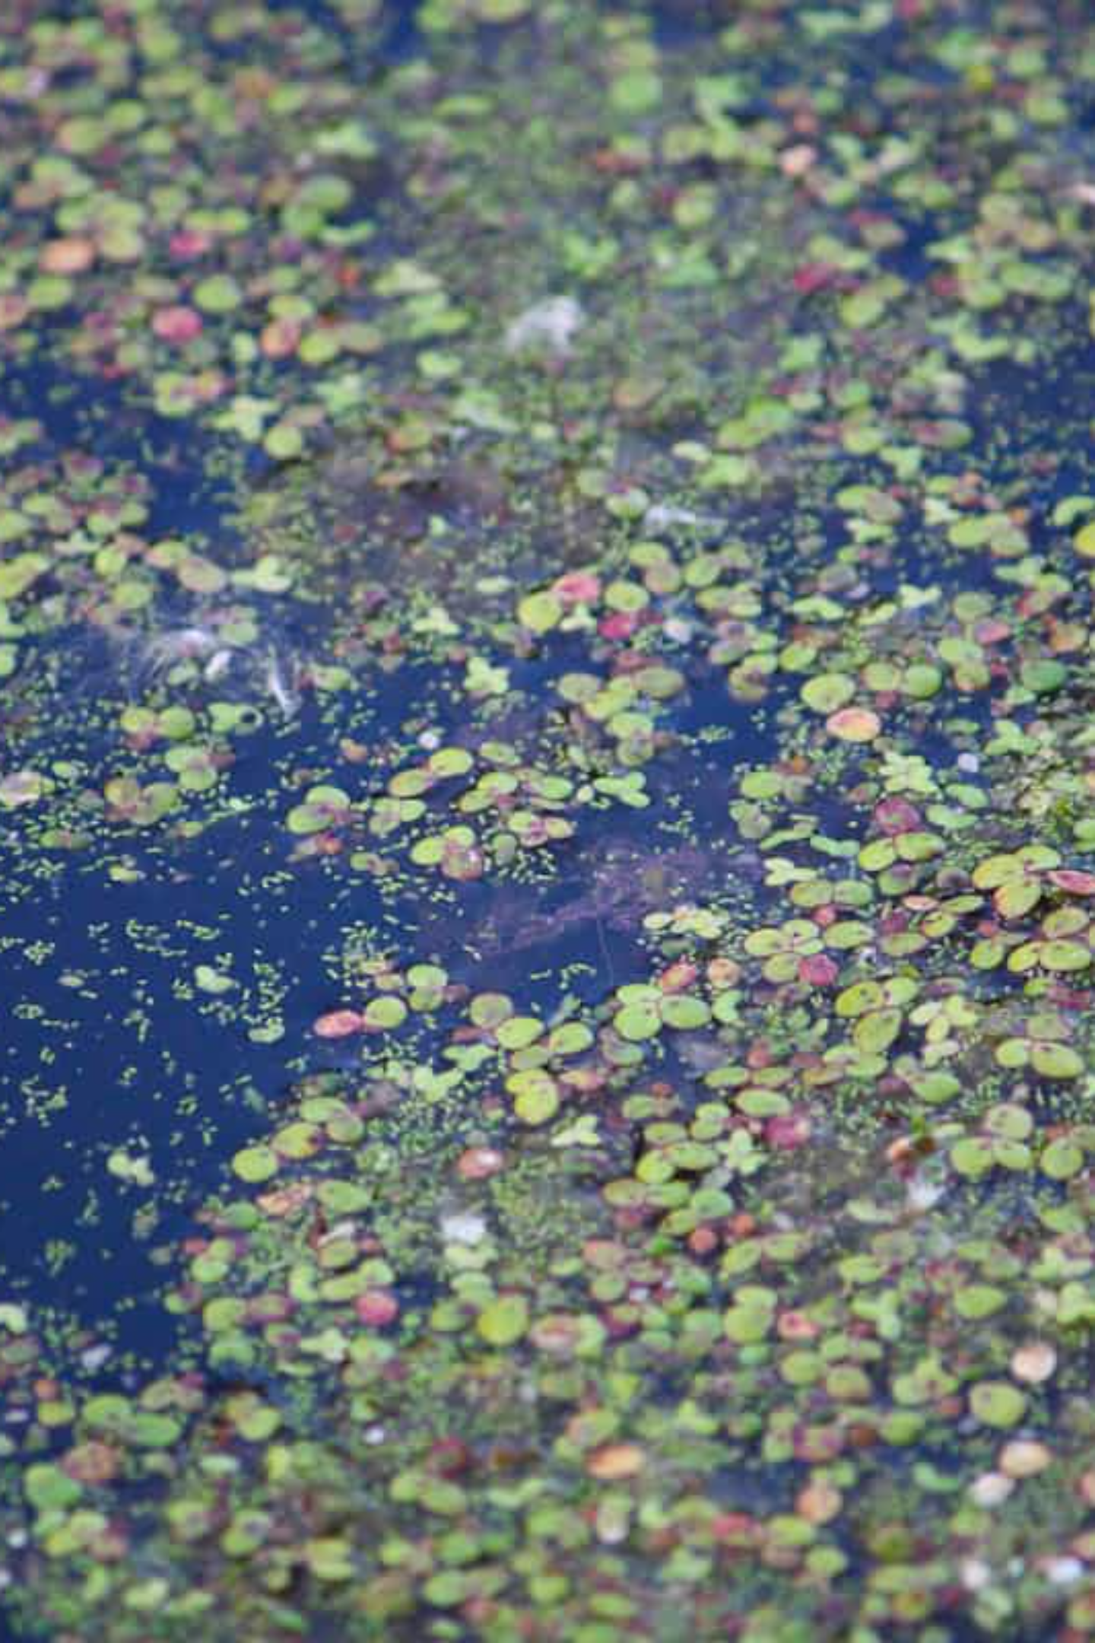
The Problem: Algal Bloom Onset
Environmental Threat
Data-Driven Prediction
Algal blooms pose significant ecological and health risks to lakes.
Using NDVI time-series and water temperature to forecast bloom occurrences.
Early Warning System
Aims to provide timely interventions for lake management.

Slide 3

Solution Overview
A machine learning pipeline to predict algal bloom onset.
01
Data Assembly
Collect NDVI (MODIS) and temperature (USGS) data, label bloom events.
02
Feature Engineering
Derive predictive features: NDVI growth, volatility, temperature averages, rainfall.
03
Modeling
Train classifiers (logistic regression, decision trees, SVM) with cross-validation.
04
Validation & Analysis
Evaluate bloom detection metrics and identify key indicators like NDVI spikes.

Slide 4





Key Components of the Solution
Data Sources
MODIS NDVI for lake surface, public water temperature data (sensors/meteorological records).
Feature Building
NDVI trends (growth rate, volatility), temperature averages, rainfall records.
Classifier Training
Logistic regression, decision tree, or support vector machine for bloom prediction.
Accuracy Validation
Analyzing prediction accuracy and identifying strong bloom indicators.

Slide 5

The Tech Stack
A lightweight, free, and widely used stack for environmental ML projects.
Python 3.x
Pandas & NumPy
Core for data handling and machine learning.
Dataframes, time-series, and numerical computations.
Scikit-learn
Matplotlib & Seaborn
Classifiers, preprocessing, and feature selection.
Visualization of trends and feature importance.

Slide 6


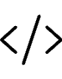
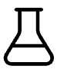
Development & Interpretability
Jupyter Notebook
Git
For interactive prototyping and experimentation.
Version control for collaborative development.
Optional Extensions
SHAP/Lime for model interpretability, Flask/Streamlit for demo apps.

Slide 7



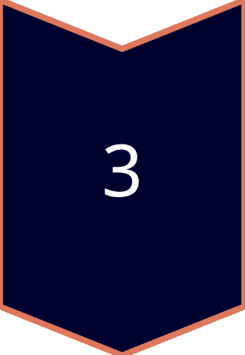
Scalability: From Prototype to Production
Modular Data Pipelines
Scales to multiple lakes by parameterizing lake coordinates.
Cloud Computing
For larger datasets, switch to AWS/GCP for storage and processing.
Real-time Integration
Integrate with live APIs and containerization (Docker) for deployment.

Slide 8
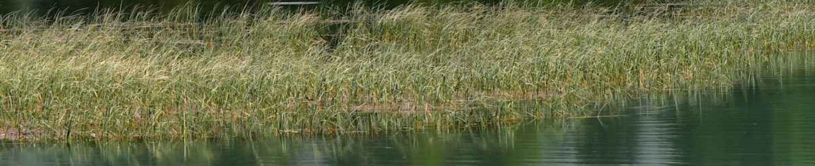
Conclusion: Impact & Future
Timely Interventions
Validated Classifier
Future Extensions
Informs lake conservation, reducing ecological and health risks.
Highlights key bloom triggers like NDVI surges during heat waves.
Paves the way for IoT sensors and deep learning for precise forecasts.

